Slide 1
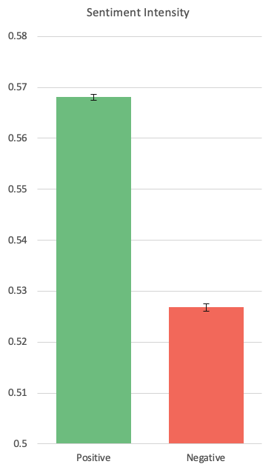
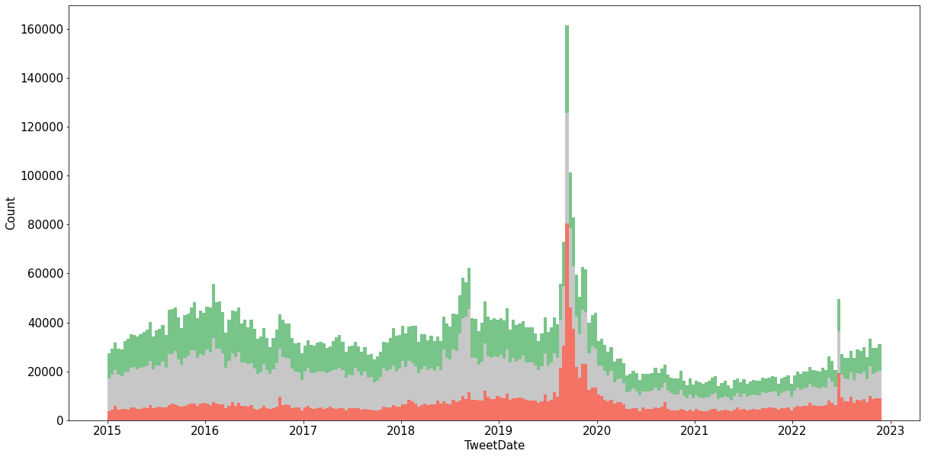
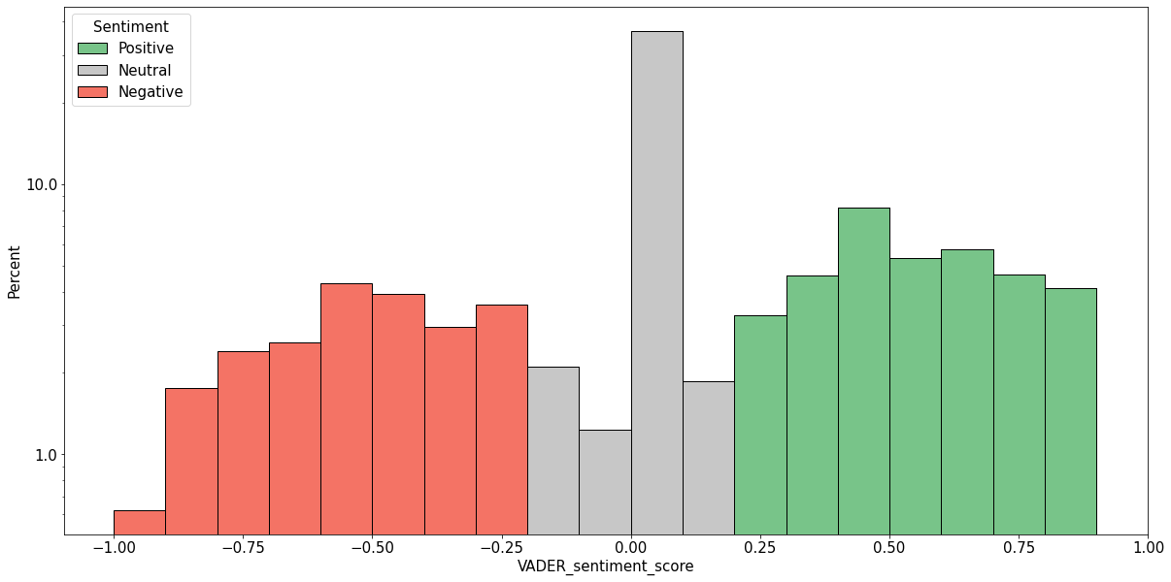
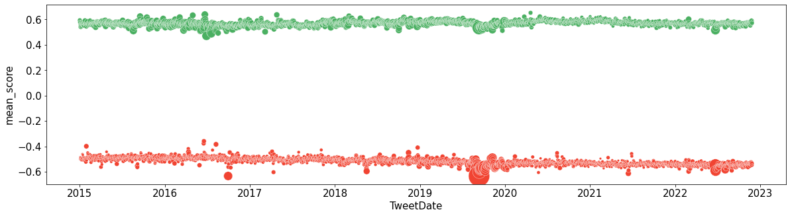
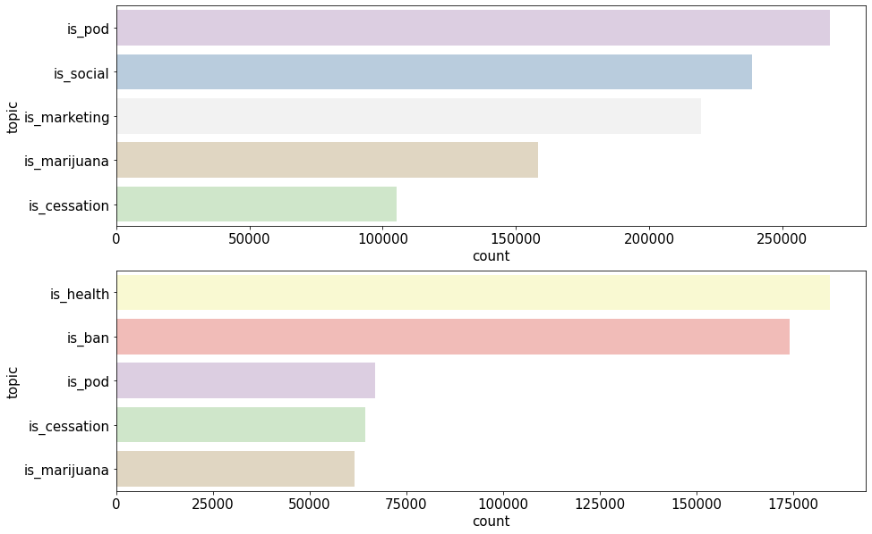
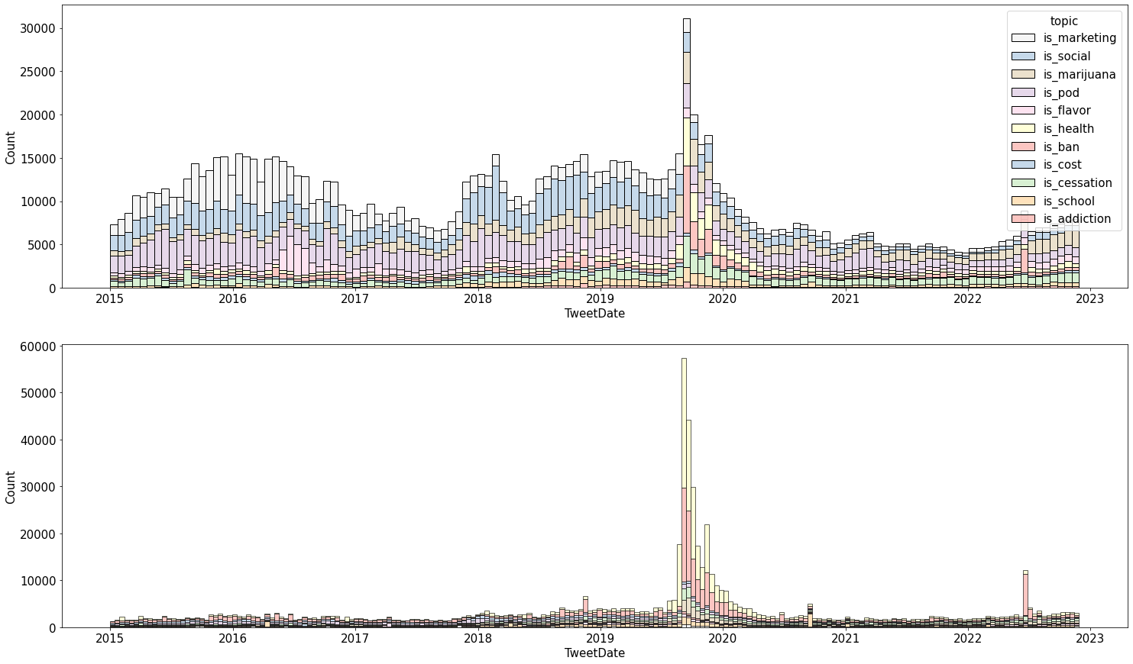
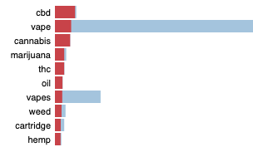
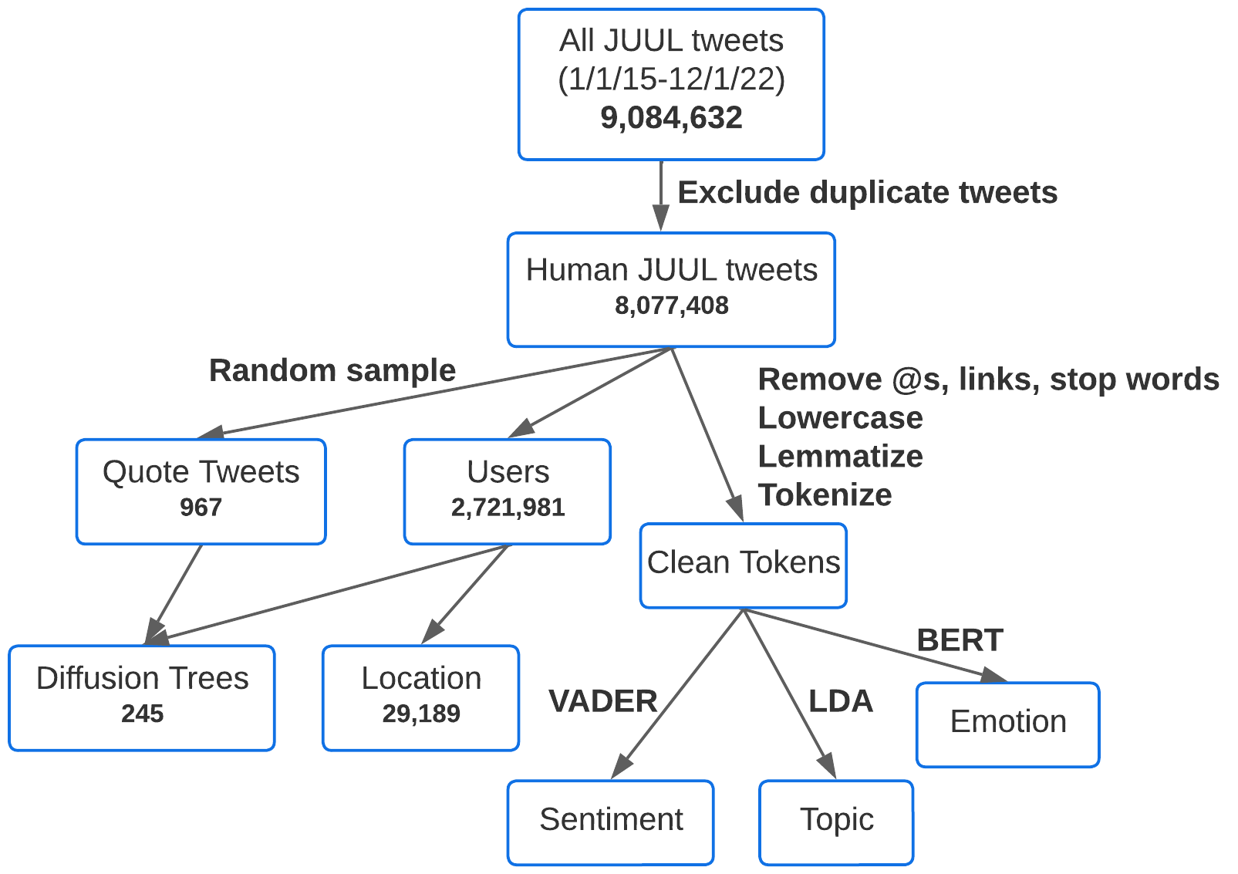
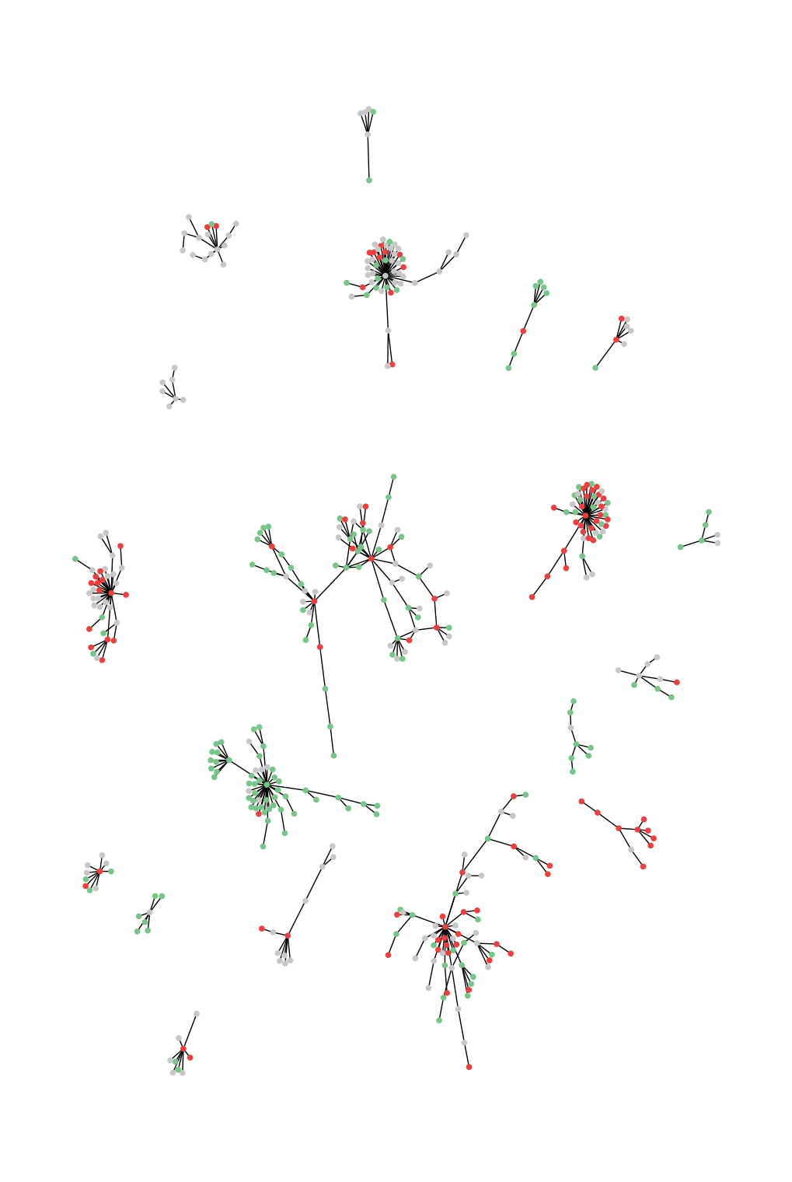
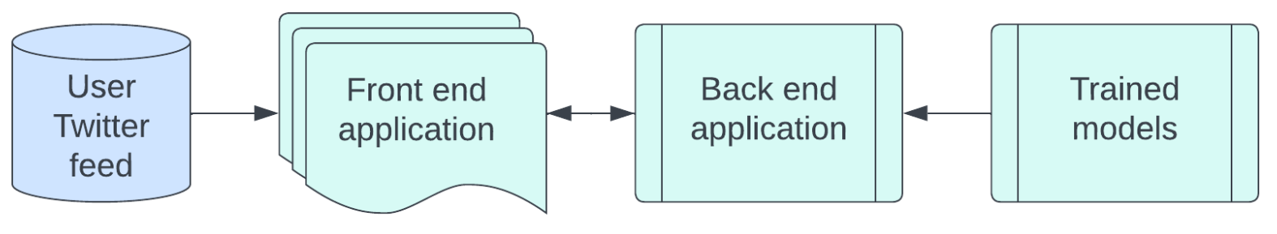


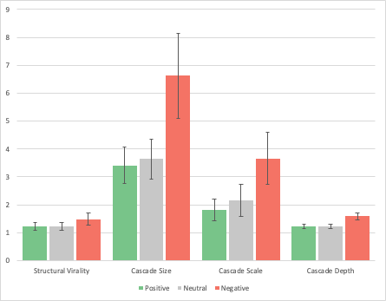

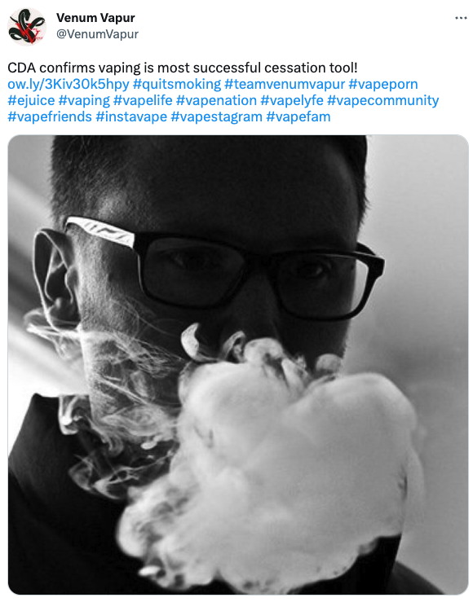
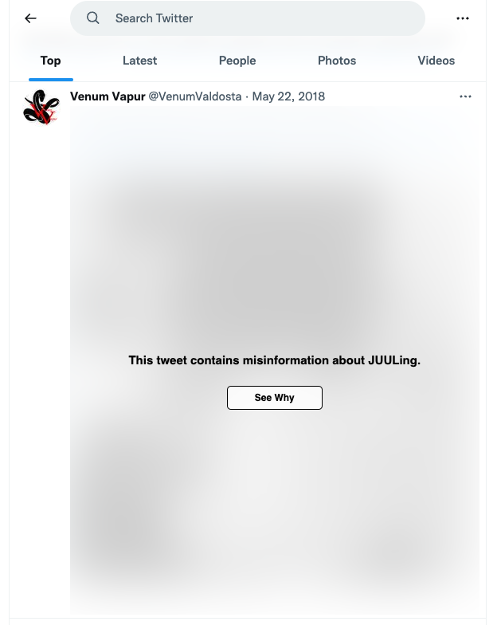
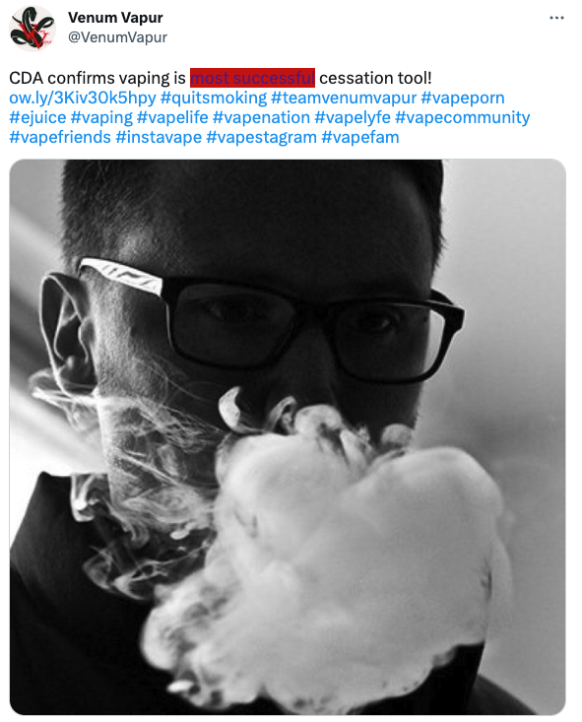
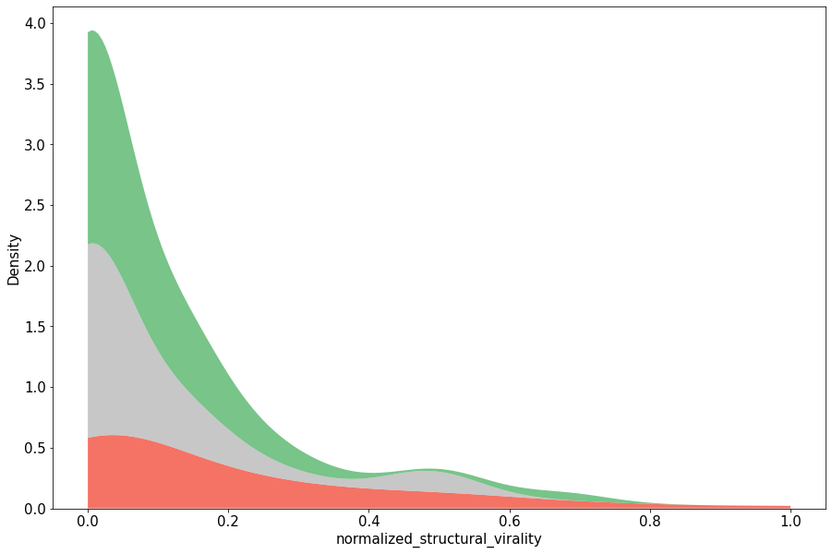
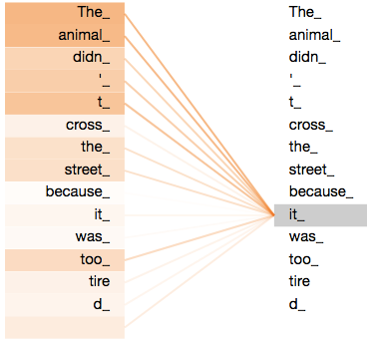
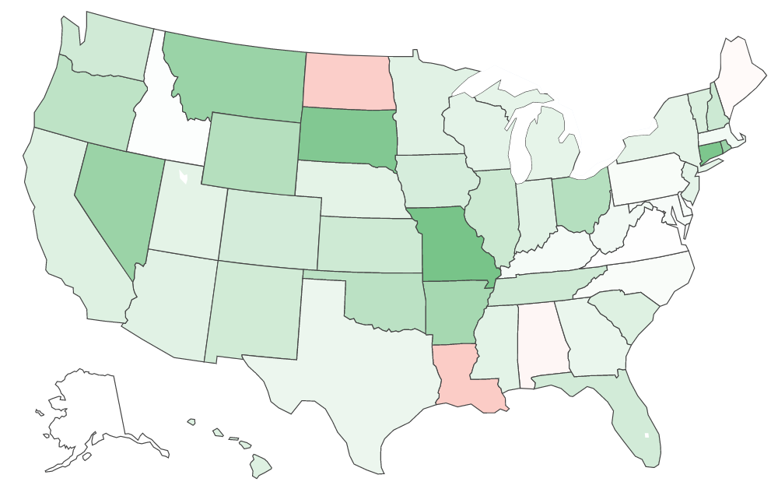
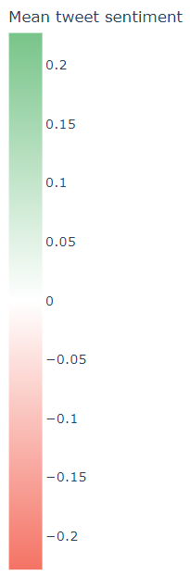
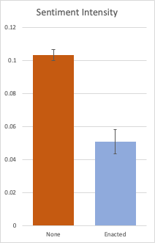
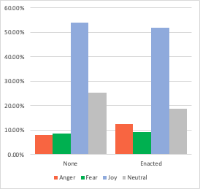
INTRODUCTION
Analyzing Public Perception and Filtering Misinformation of JUUL on Twitter: A Natural Language Processing Approach
DISCUSSION
E-Cigarettes (EC)
ECs contain nicotine in similar amounts as cigarettes as well as toxic metals that hinder adolescent brain development
Approximately 3.6 million, or 20%, of American high schoolers have vaped before (FDA, 2021)
JUUL controls over 50% of the American EC market
JUUL’s growth is primarily driven by American youth
Misinformation
Misinformation is widespread and increasing on social media (Wang et al., 2019; Chen et al., 2023)
Exposure to EC advertisements on social media is associated with future usage in adolescents (Camenga et al., 2018)
Advertising flavored ECs on Twitter increases interest in young consumers (Sowles et al., 2016)
EC brands advertise their products as smoking cessation tools and safer than traditional cigarettes (NASEM, 2018)
Over half of youth who used ECs believed that they don’t contain nicotine (Pepper and Farrelly, 2018)
Social bots, often created to influence discussions or promote products, generate more tweets than the average human user, and are more likely to post hashtags that reference smoking cessation and new EC devices (Allem et al., 2017)
Natural Language Processing (NLP)
Twitter is popular for public surveillance
Large dataset of user-generated content, often difficult to obtain through surveys (Myslín et al., 2013)
40% of Twitter users are 25-34 y.o. (Sloan et al., 2015)
NLP is a field of AI that analyzes textual data, and is an effective method to analyze millions of daily tweets (Visweswaran et al., 2020; Edo-Osagie et al., 2020; Jordan et al., 2018)
Specific topics associated with positive sentiment and the methods underlying the spread of vaping-related tweets have not yet been examined
Application
Currently, social media platforms like Twitter do not show warnings on posts containing potentially misleading JUULing information
Opinion-based blogs rather than health/news organizations are the primary sources of health information on Twitter, meaning reliable information is not accessible (Myslín et al., 2013)
Sentiment and Emotion Patterns
Overall, there were 50% more tweets expressing positive than negative sentiment, which is consistent with past literature
This suggests that JUUL's marketing strategies may have been successful in creating a positive image of their products in social media users, particularly in youth
Tweets expressing positive sentiment were significantly more intense compared to negative sentiment tweets
The greater intensity of positive sentiment indicates that users who support JUUL are more likely to be vocal about their views on Twitter
The total volume of tweets related to JUULing is less in recent years, but the breakdown remains consistent over time
Two main spikes when JUUL made mainstream headlines:
Vaping-associated lung injury outbreak in August 2019
JUUL’s marketing denial order in July 2022
Both spikes are associated with disproportionately increased negative sentiment and polarized intensity
Increased negative sentiment during these spikes could suggest that mainstream news headlines influenced public opinion about JUUL, especially in relation to health risks and marketing practices
Emotion trends (anger, fear, joy, neutral) support sentiment patterns
Fear and anger were proportionately higher in negative sentiment tweets, while joy was more pronounced in positive sentiment tweets
Common Topics and Misconceptions
Flavors, social perception, and marketing were dominant topics in JUUL’s early years
This quantitatively validates part of a JUUL study by SRITA that proposed JUUL’s explosive growth was driven primarily by its virality on social media and appeal to youth through influencers, trendy perception, and advertising ‘refreshing’ flavors (Jackler et al., 2019)
In recent years, there has been increased discussion about marijuana
Discussion about both the health risks and bans topics increased by over 1000% during the EVALI outbreak, but was not sustained
Geographical Analysis
Tweets from states that have introduced Tobacco 21, a campaign aimed to raise the legal age of purchase of tobacco/nicotine products to 21, show significantly more negative sentiment intensity to JUULing
There is no statistical difference between states that have only introduced T21 and those that have enacted T21
Tweets from states that have introduced or passed T21 have higher proportions of anger and fear and decrease in neutral emotions suggesting that these states are more polarized
Dissemination Network
JUUL mean normalized structural virality of 0.104 is twice as viral as Liang’s observed value of 0.05 in the context of Ebola (Liang et al., 2019)
JUUL tweeters may be younger and more active on social media
JUUL may also have less coverage from mainstream media sources
Negative sentiment tweets spread more virally, while positive sentiment tweets tend to spread more through broadcast methods (p = 0.003)
A larger proportion of positive sentiment tweets are generated by social bots, which may see less online interaction
Negative views may be more controversial,causing extended discussions
9 times out of 10, direct retweets share sentiment with the original tweet. Each tweet further removed from the original conversation is 1.2 times more likely to disagree with the original tweet
Twitter JUUL discussions may be happening within echo chambers
Alexander Xu and Sarah Sun
SENTIMENT
Fig 1b: Sentiment Intensity
Fig 2a: Tweet volume and mean sentiment intensity score stratified by sentiment over time
VADER, a rule-based model, was used for sentiment analysis (positive, negative, neutral) (Hutto and Gilbert, 2014).
p<0.001
EVALI outbreak
Marketing Denial Order
Fig 1a: Distribution of sentiment intensity scores
Fig 2b
Valence Aware Dictionary for Sentiment Reasoning (VADER) was used to classify tweet sentiment. Significantly more tweets expressed positive than negative sentiment.
Tweets expressing positive sentiment were more intense (mean ± 1 SE), two-tailed T-test
TOPIC
Fig 4a: Topics across time (positive)
LDA, a statistical model, was used for topic modeling (Prier et al., 2011).
Fig 3a: Top topics (positive)
Fig 4a: Topics across time (negative)
Words commonly used in the same context are grouped into a single topic
Fig 3b: Top topics (negative)
Latent Dirichlet Allocation (LDA) was used to find common topics/misconceptions.
METHODOLOGY
DISSEMINATION
APPLICATION
Structural virality scores were used to quantify information spread (Liang et al., 2019)
virality=0.32
virality=0.50
+0.5983 (positive)
CONCLUSION
-0.3612 (negative)
Overall, Twitter users have more positive perceptions towards JUUL
In JUUL’s early years, common topics discussed included flavors and marketing, while recently there has been more discussion about marijuana
Events like the EVALI outbreak in 2019 saw significant changes in tweet patterns
Tweet diffusion networks generally spread via viral methods, more so for tweets with negative sentiment
This research and our application will help policy makers and educational campaigns implement more effective preventive and quitting strategies, and better elucidate the dynamics of the spread of tweets and factors that influence positive sentiment to help social media platforms implement corrective actions
p=0.033
Fig 6: Cascade parameters
Fig 5: KDE of structural virality by sentiment
p=0.041
p=0.009
p=0.003
p=0.005
p=0.007
LIMITATIONS & FUTURE RESEARCH
Unfiltered feed
Plugin hides post (misinformation detected)
Misleading terms are highlighted and linked to reliable sources
Limitations
The sample size of extracted information for dissemination networks was small, due to access restrictions of the Official Twitter API
Application models may become outdated as trends change
Future Research
The relationship between marijuana and JUUL should be analyzed, given the association between usage of ECs and other forms of substance abuse
Similar trends and applications can be realized on different social media and online platforms
More in-depth geographic and demographic analysis, along with the addition of social bot detection (Allem et al., 2017) to our Twitter plugin, will enable improved effectiveness of preventative actions on social media
RESEARCH GOALS
LOCATION
Determine the patterns in sentiment, emotions, topics, and changes in metrics in relation to JUUL misconceptions and JUUL-related events and legislation over time
Determine the method of JUUL information dissemination and how sentiment affects its dynamics
Determine public perceptions of JUULing in areas where JUUL products are heavily regulated
Create a Twitter-based plugin to filter tweets containing potentially misleading information about JUULing, and provide users with more reliable sources of information
p<0.001
χ2=128.18768 p<0.001
BERT, a transformer model, was used for emotion analysis (Saravia et al., 2018).
Fig 7: Mean sentiment intensity by US state
REFERENCES
BERT uses attention mechanisms, which understands the meaning of words using their context
Fig 8a: Positive sentiment intensity by T21
Fig 8b: Emotion by T21
Allem, J.-P., Dharmapuri, L., Unger, J. B., & Cruz, T. B. (2018). Characterizing JUUL-related posts on Twitter. Drug and Alcohol Dependence, 190, 1–5. https://doi.org/10.1016/j.drugalcdep.2018.05.018
Camenga, D., Gutierrez, K. M., Kong, G., Cavallo, D., Simon, P., & Krishnan-Sarin, S. (2018). E-cigarette advertising exposure in e-cigarette naïve adolescents and subsequent e-cigarette use: A longitudinal cohort study. Addictive Behaviors, 81, 78–83. https://doi.org/10.1016/j.addbeh.2018.02.008
Chen, S., Xiao, L., & Kumar, A. (2023). Spread of misinformation on social media: What contributes to it and how to combat it. Computers in Human Behavior, 141, 107643. https://doi.org/10.1016/j.chb.2022.107643
Edo-Osagie, O., De La Iglesia, B., Lake, I., & Edeghere, O. (2020). A scoping review of the use of Twitter for public health research. Computers in Biology and Medicine, 122, 103770. https://doi.org/10.1016/j.compbiomed.2020.103770
Guiñazú, M. F., Cortés, V., Ibáñez, C. F., & Velásquez, J. D. (2020). Employing online social networks in precision-medicine approach using information fusion predictive model to improve substance use surveillance: A lesson from Twitter and marijuana consumption. Information Fusion, 55, 150-163. https://doi.org/10.1016/j.inffus.2019.08.006
Jackler, R. K., Chau, C., Getachew, B. D., & Ramamurthi, D. (2019). JUUL Advertising Over its First Three Years on the Market. SRITA. https://tobacco.stanford.edu/
Jordan, S., Hovet, S., Fung, I., Liang, H., Fu, K.-W., & Tse, Z. (2018). Using Twitter for Public Health Surveillance from Monitoring and Prediction to Public Response. Data, 4(1), 6. https://doi.org/10.3390/data4010006
Liang, H., Fung, I.CH., Tse, Z.T.H., Yin, J., Chan, CH., Pechta, L.E., Smith, B.J., Marquez-Lameda, R.D., Meltzer, M.I., Lubell, K.M., Fu, KW (2019). How did Ebola information spread on twitter: broadcasting or viral spreading?. BMC Public Health 19, 438. https://doi.org/10.1186/s12889-019-6747-8
Pepper, J. K., Farrelly, M. C., & Watson, K. A. (2018). Adolescents’ understanding and use of nicotine in e-cigarettes. Addictive Behaviors, 82, 109–113. https://doi.org/10.1016/j.addbeh.2018.02.015
Sailunaz, K., & Alhajjab, R. (2019). Emotion and sentiment analysis from Twitter text. Journal of Computational Science, 36. https://doi.org/10.1016/j.jocs.2019.05.009
Sowles, S. J., Krauss, M. J., Connolly, S., & Cavazos-Rehg, P. A. (2016). A Content Analysis of Vaping Advertisements on Twitter, November 2014. Preventing Chronic Disease, 13. https://doi.org/10.5888/pcd13.160274
Visweswaran, S., Colditz, J. B., O'Halloran, P., Han, N.-R., Taneja, S. B., Welling, J., Chu, K.-H., Sidani, J. E., & Primack, B. A. (2020). Machine Learning Classifiers for Twitter Surveillance of Vaping: Comparative Machine Learning Study. Journal of Medical Internet Research, 22(8). https://doi.org/10.2196/17478
Wang, Y., McKee, M., Torbica, A., & Stuckler, D. (2019). Systematic Literature Review on the Spread of Health-related Misinformation on Social Media. Social Science & Medicine, 240, 112552. https://doi.org/10.1016/j.socscimed.2019.112552

